Slide 1

Toronto Neighborhood Clustering

Slide 2
Postal codes clustering of the city of Toronto, Canada, using the venues density

Slide 3
Introduction
In this notebook is presented the segmentation and clustering of the Postal codes' division of the city of Toronto in the province of Ontario, Canada, extracted from "List of postal codes of Canada: M" in Wikipedia (https://en.wikipedia.org/wiki/List_of_postal_codes_of_Canada:_M).
The Foursquare API was used to find the venues on each postal code zone using a radius based on the area cover by each postcode without overlapping between them and a maximum number of venues per postal code of 100. Using K-Means clustering algorithm, the postal codes were grouped based on the venues density (venues/area) and the result was showed on a map of Toronto.

Slide 4
Table of Contents
Extract data of Toronto neighborhoods from Wikipedia
Explore and clean neighborhoods dataset
Get venues
Analyze venues dataset
Cluster Postcodes
Examine Clusters

Slide 5
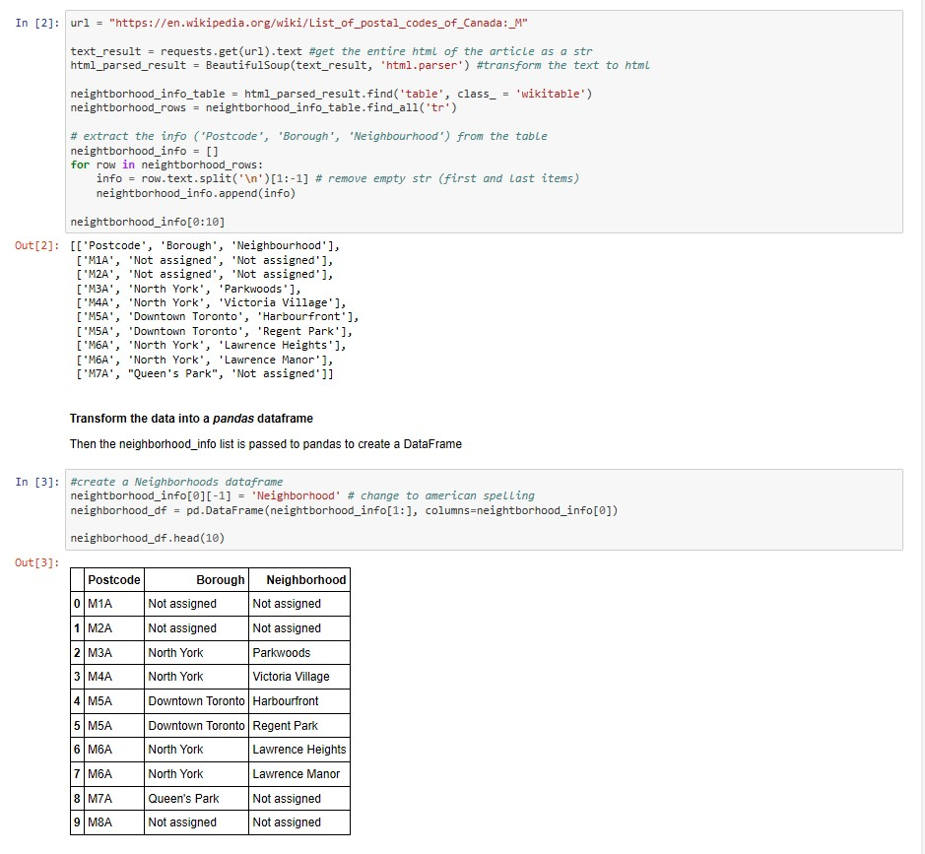
1. Extract data of Toronto neighborhoods from Wikipedia
BeautifulSoup library is used to scrape the Wikipedia's article that contains the Toronto neighborhood. The neighborhood data presented in a Table on the article is parsed and stored in a list that contains each row of the table, that is the Postcode, Borough and Neighborhood name.

Slide 6
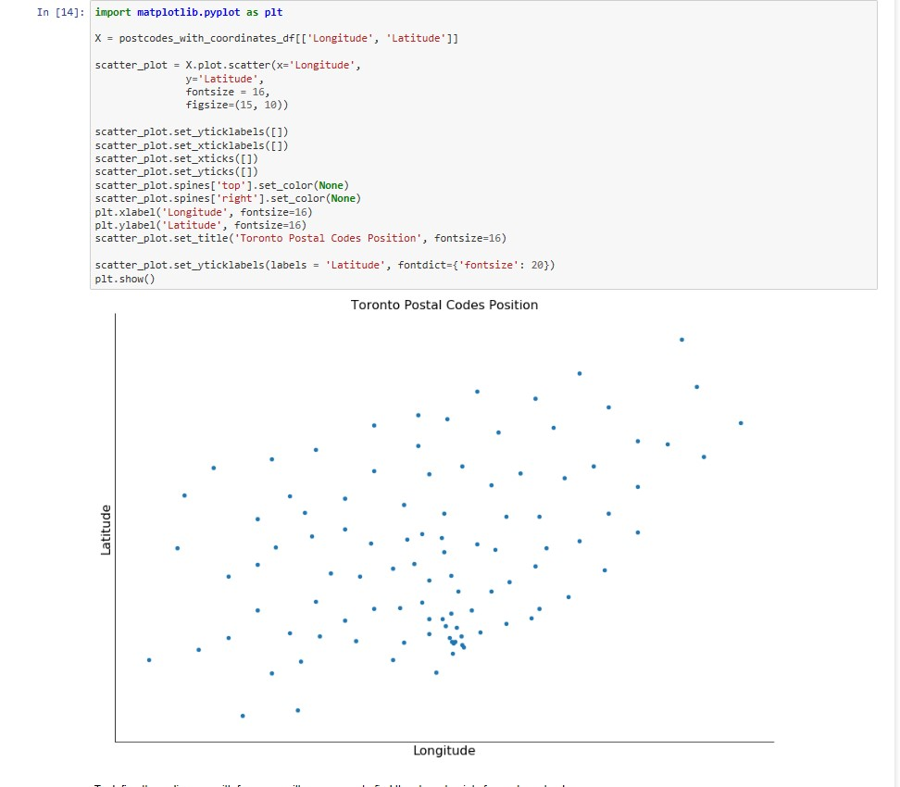
2. Explore and clean neighborhoods dataset
The data returned has missing info like "Not assigned" boroughs and neighborhoods.

Slide 7
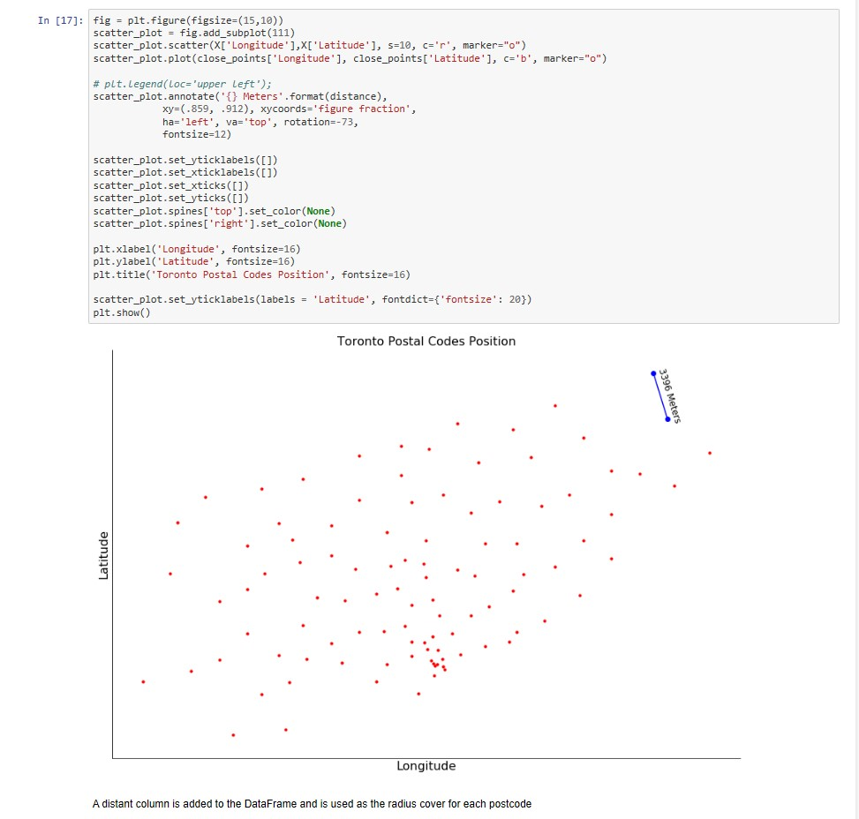

Slide 8
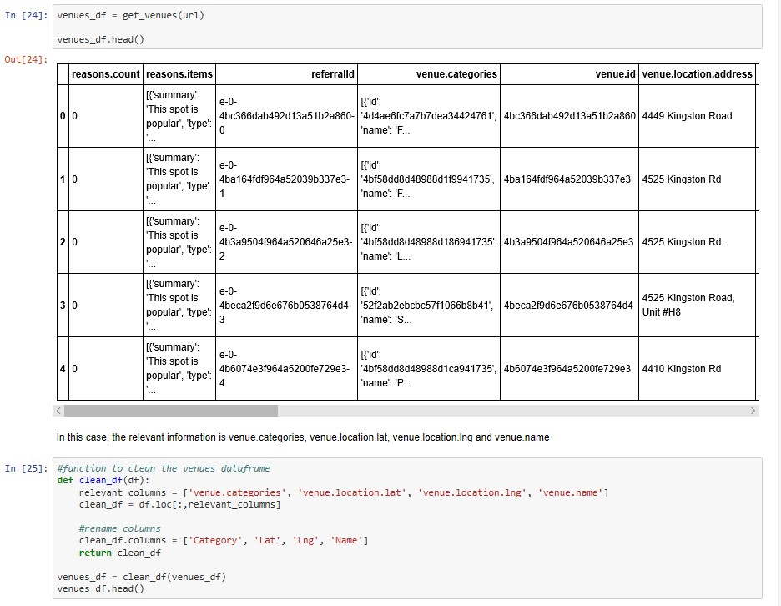
3. Get Venues
In order to get the venues in the perimeter of each Postal code, it is necessary to get the geographical coordinates (lat and lng) of each one of those and add them to the dataframe. The geopy library is not compatible with Canada's postcode and geocoder is an unreliable library. For that reason the coordinates are in the csv file 'Geospatial_Coordinates.csv".

Slide 9
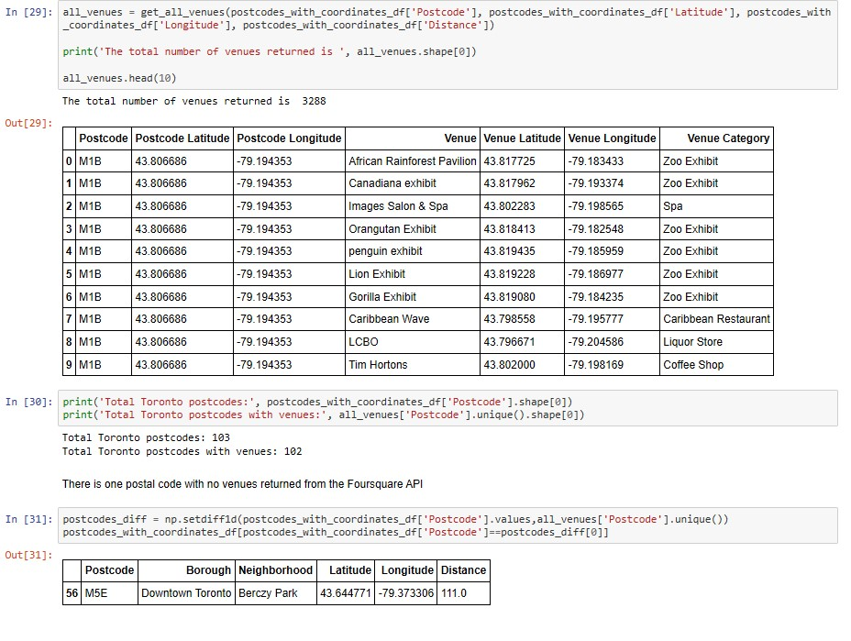
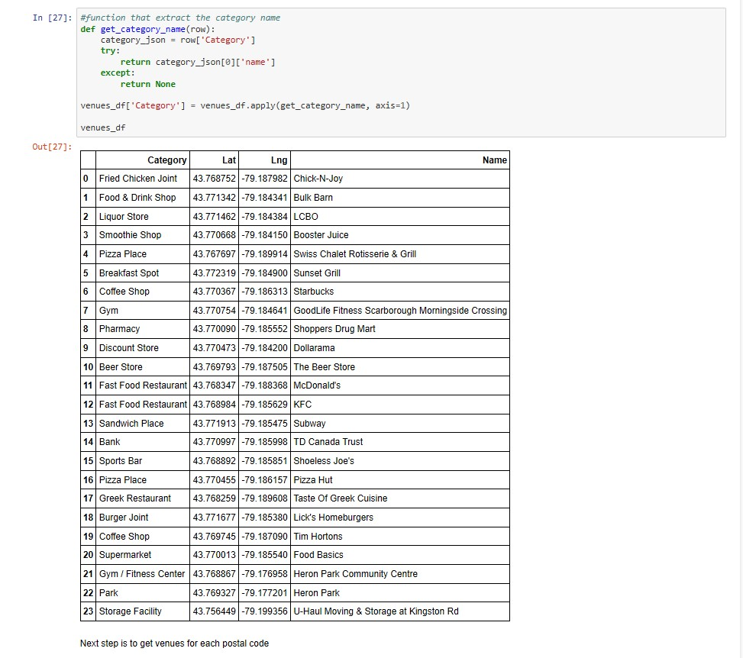

Slide 10
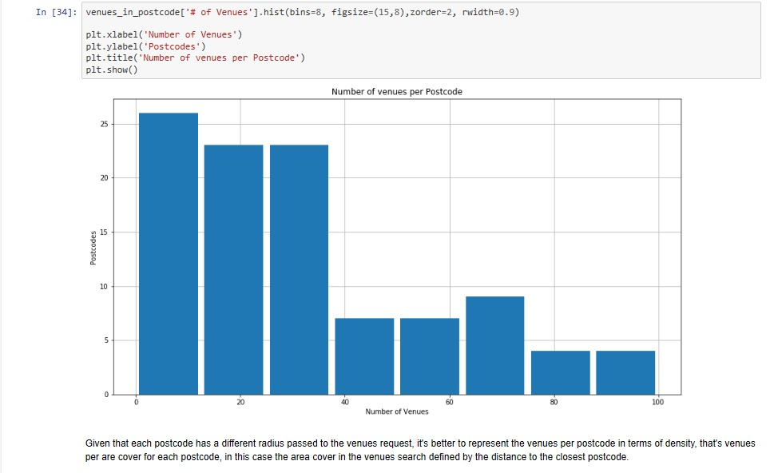
4. Analyze venues data
In order to get a better sense of the best way of clustering the postalcodes, it's necessary to analyze the venues data returned by Foursquare.

Slide 11
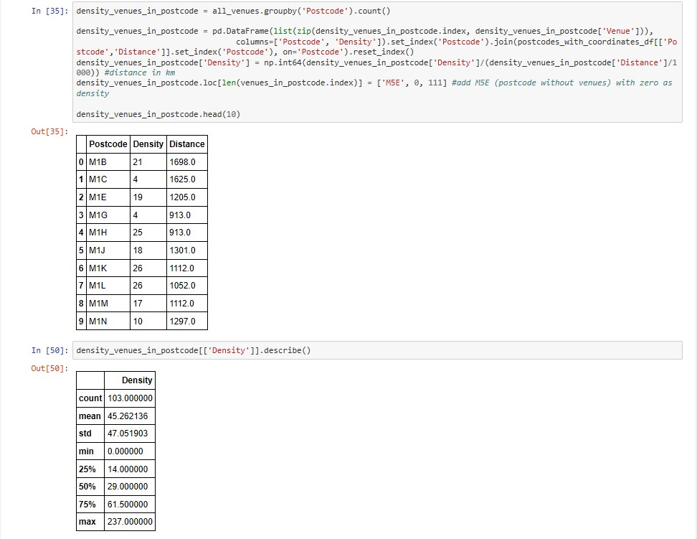
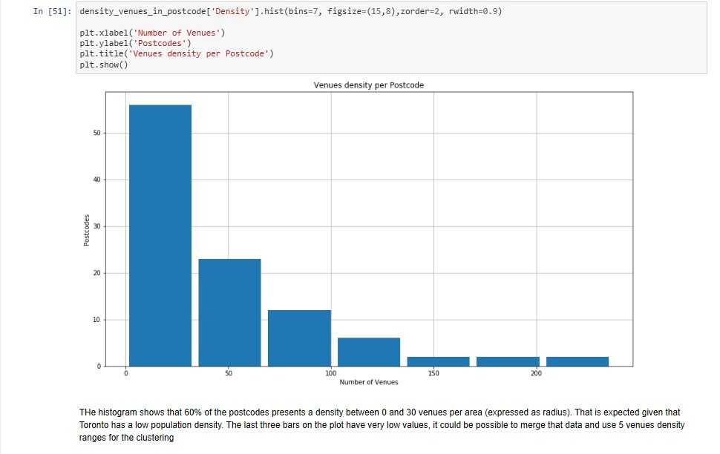

Slide 12
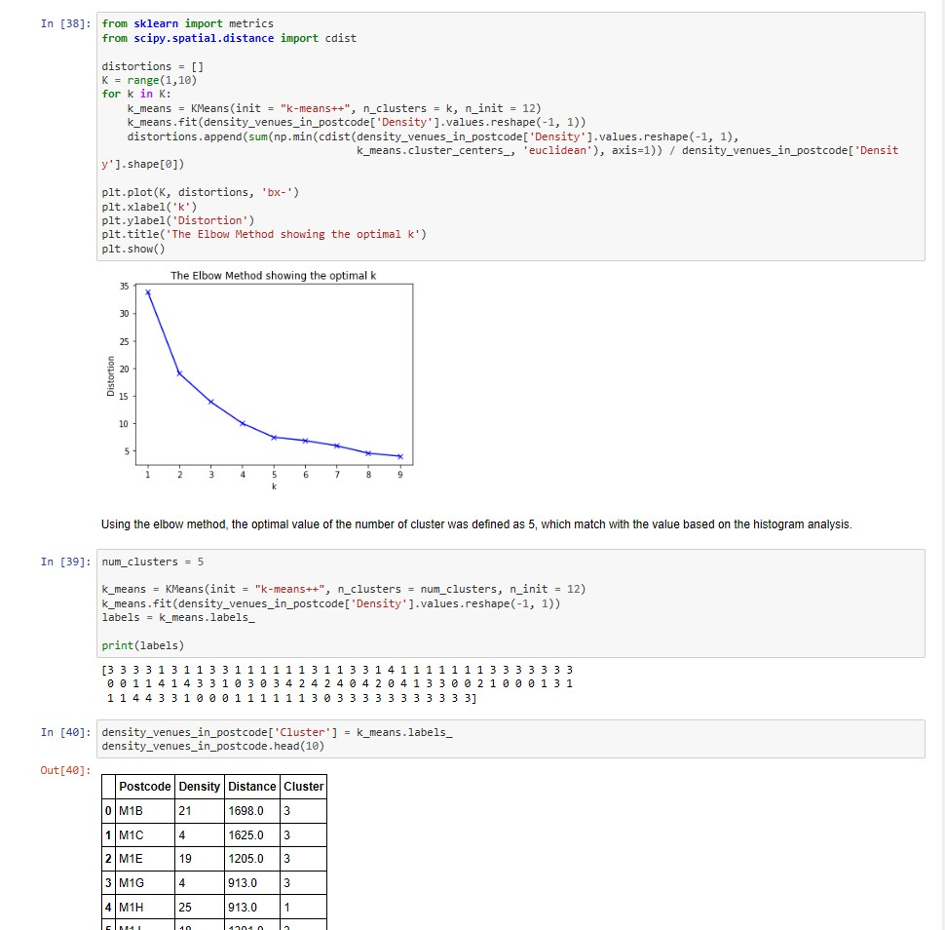
5. Cluster Postcodes
Next the postcodes are clustered based on venues density. One important hyperparameter is the number of clusters and based on previous analysis a tentative value is five clusters. Next the elbow method is used to have a better sense of the optimal number.

Slide 13
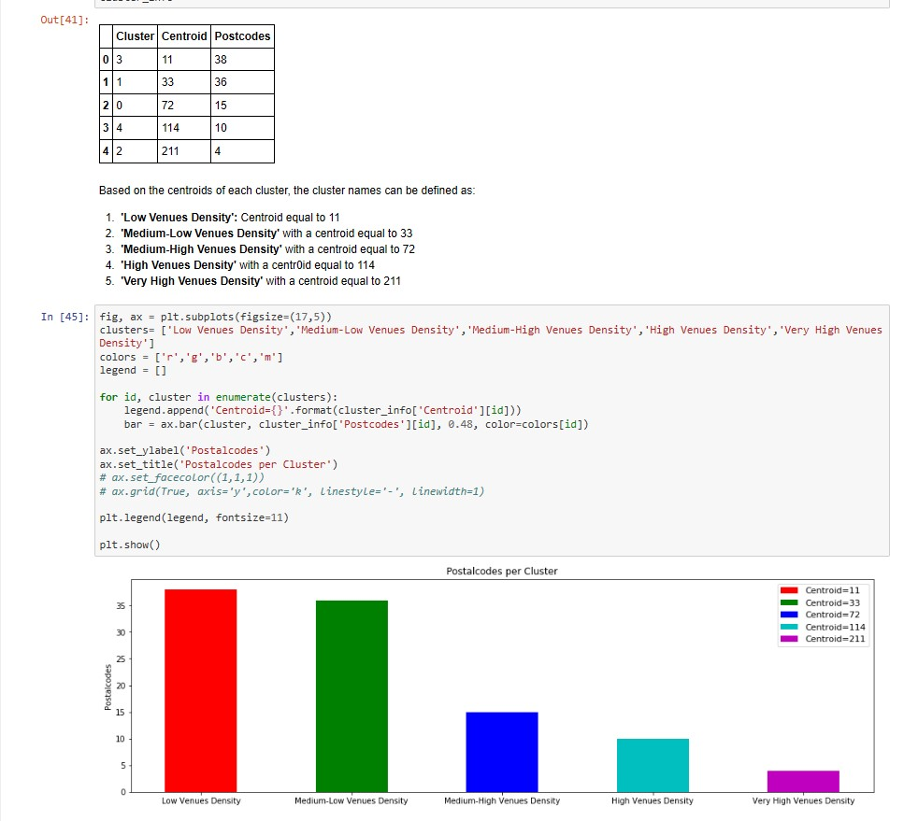
6. Examine clusters
Check the centroids values of venues density and postcodes per cluster

Slide 14
Usage
The results showed on the map could be useful, among others, in:
Real estate: as part of property cost model (venues density could be related to the cost of a property) or as a tool for property search.
Epidemiology research: venues density could be related with noise, pollution or crime.

